Slide 1
Kahoots ES

Slide 2
Index
Introduction
Software Processes, RUP & XP
Requirements Engineering; Use Case and Domain Modeling
Architecture and Design
Software Testing Verification & Validation
Using JSON Web APIs in Dart
(não sai no exame)
Behavior Modeling in UML
Software Project Management
Mobile Technologies
Scrum
Software Construction and Evolution

Slide 3
Introduction

Slide 4
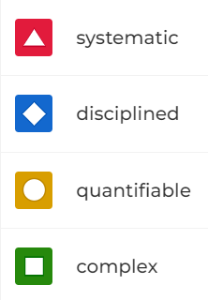

Slide 5
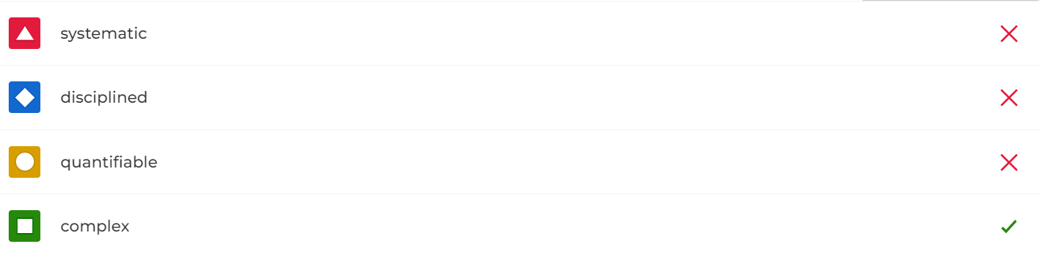

Slide 6
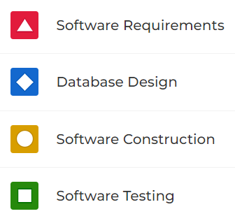

Slide 7
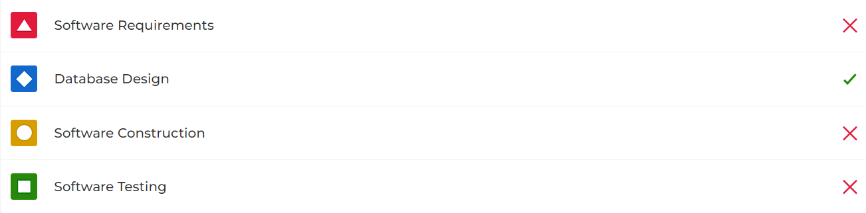

Slide 8
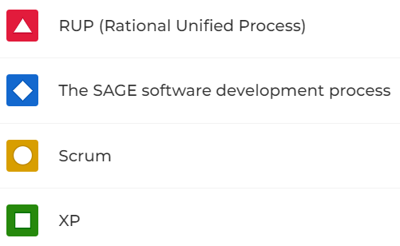

Slide 9
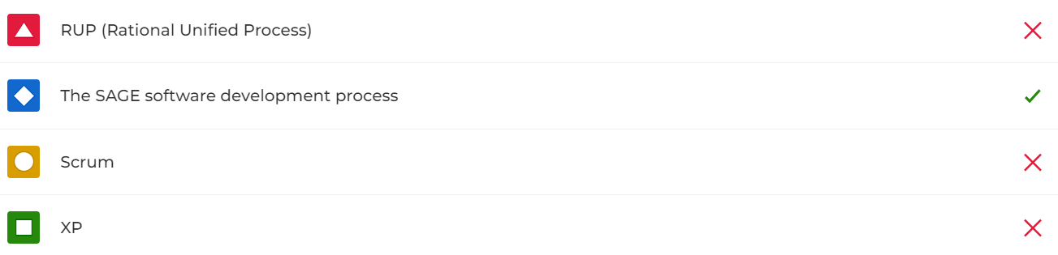

Slide 10
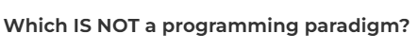
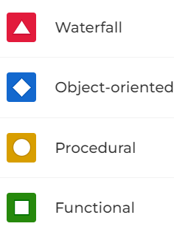

Slide 11
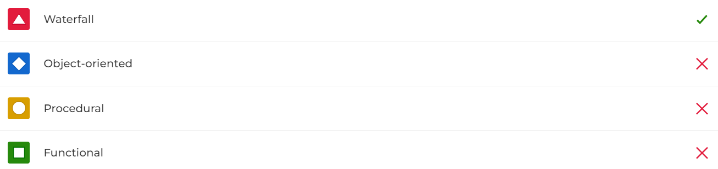

Slide 12

Software process model?
Waterfall
Interactive
Spiral
Unified

Slide 13

Waterfall
Interactive
Spiral
Unified

Slide 14
Software process?
CRIPS-DM
XP
Scrum
RUP

Slide 15
CRIPS-DM
XP
Scrum
RUP

Slide 16
Software Processes, RUP & XP

Slide 17
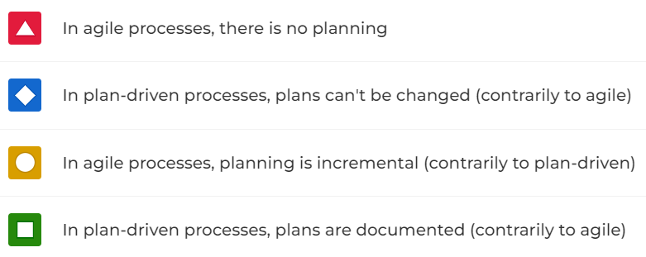

Slide 18
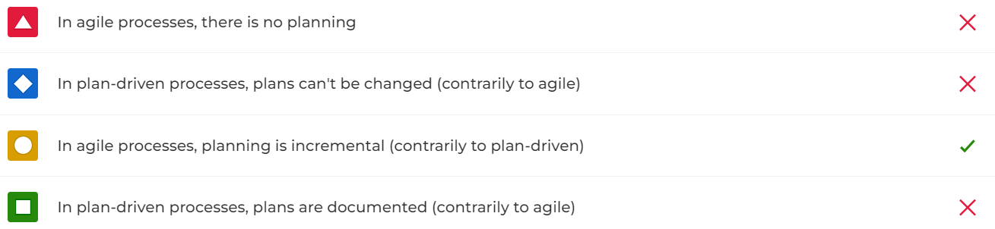

Slide 19
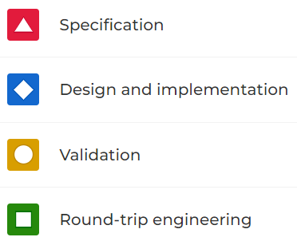

Slide 20
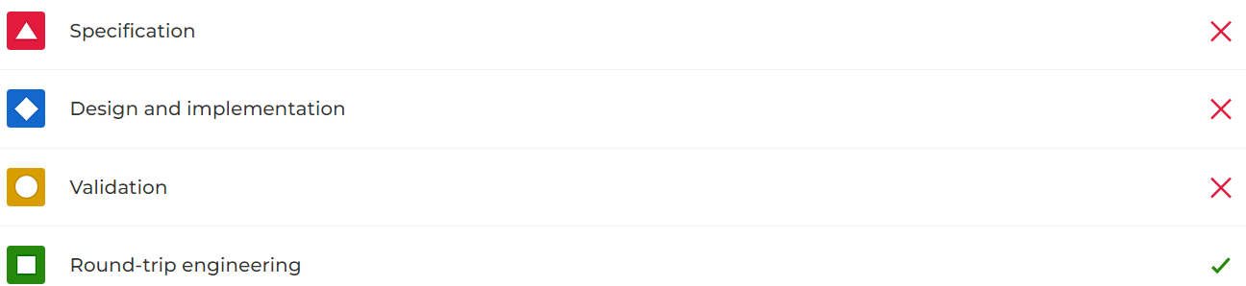

Slide 21
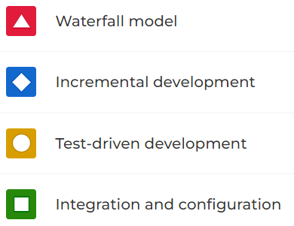

Slide 22
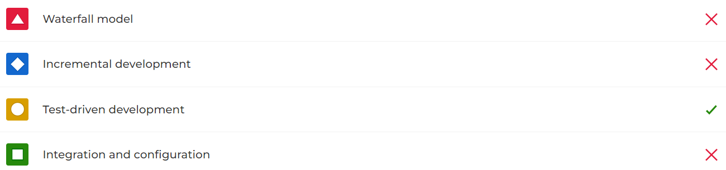

Slide 23
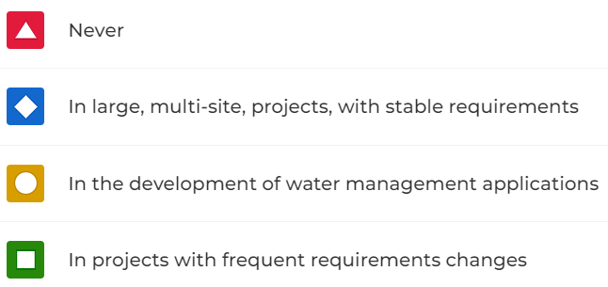

Slide 24
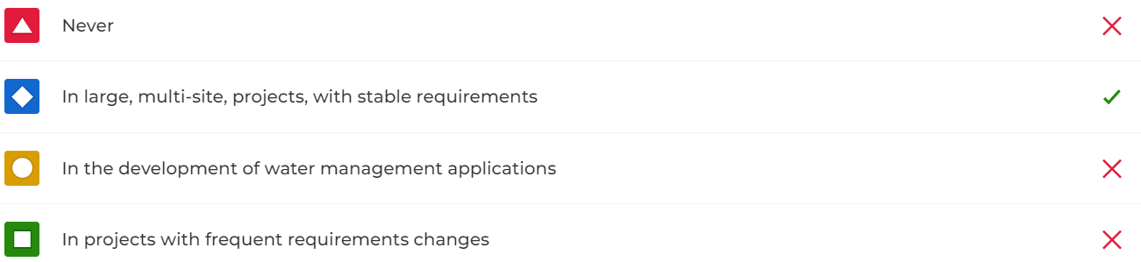

Slide 25
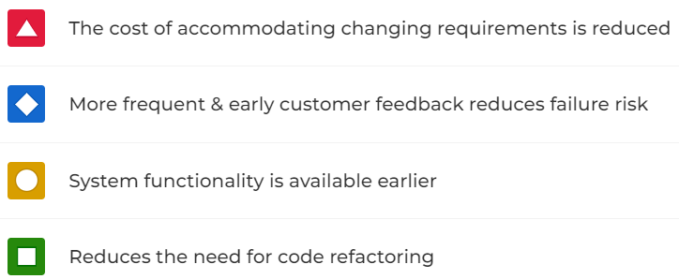

Slide 26
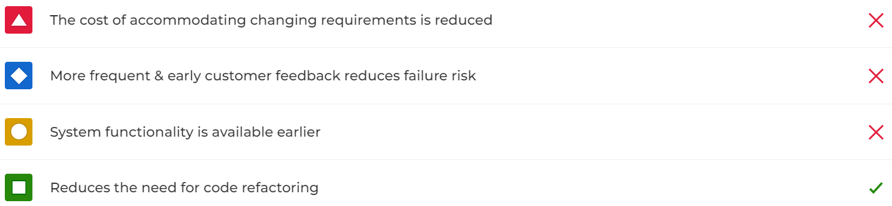

Slide 27
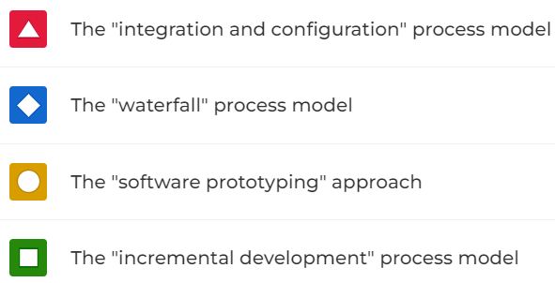

Slide 28
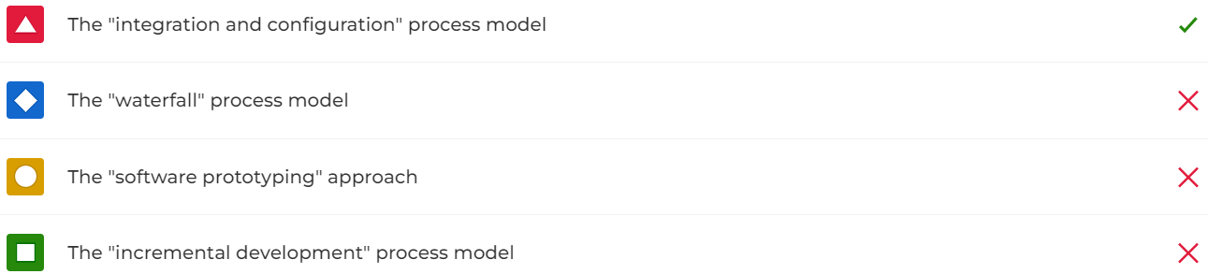

Slide 29
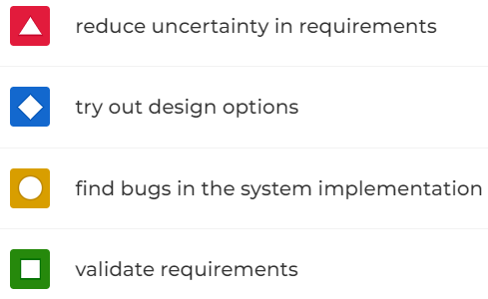

Slide 30
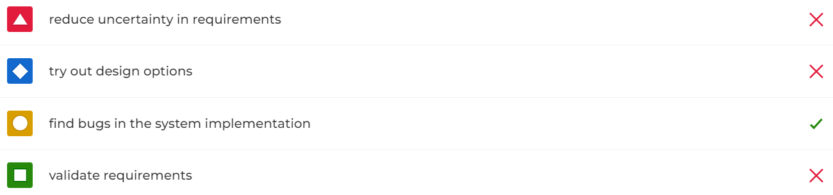

Slide 31
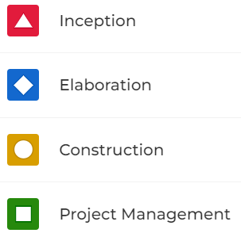

Slide 32
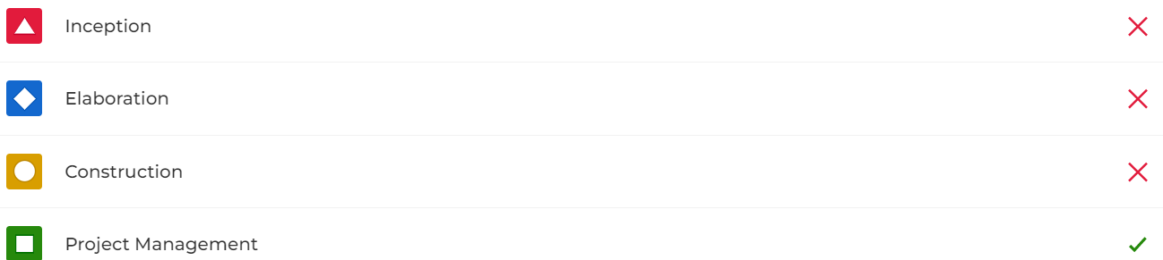

Slide 33
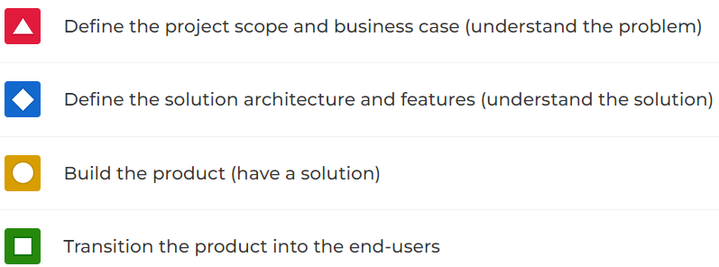

Slide 34
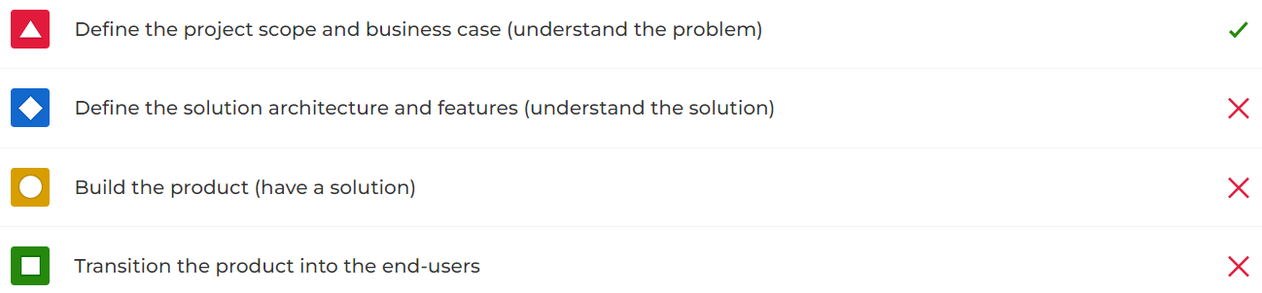

Slide 35
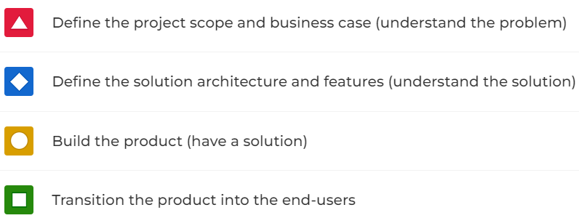

Slide 36
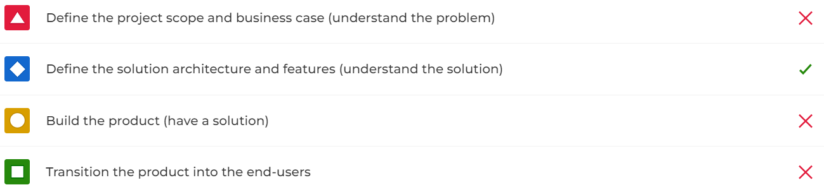

Slide 37
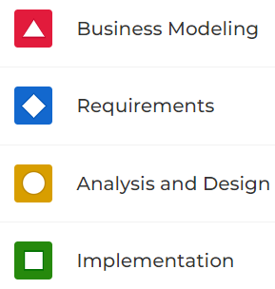

Slide 38
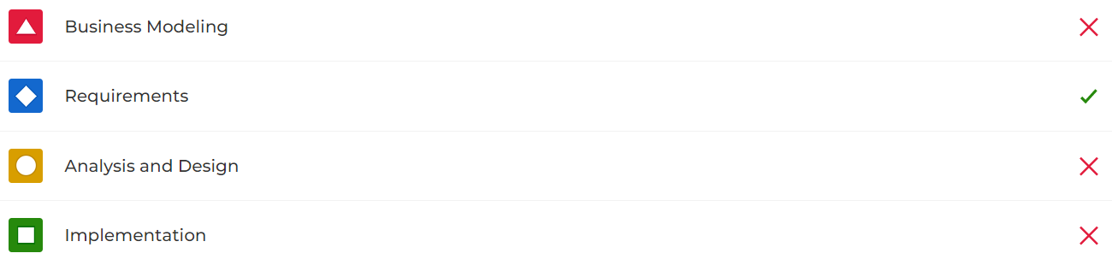

Slide 39
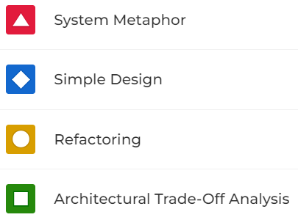

Slide 40
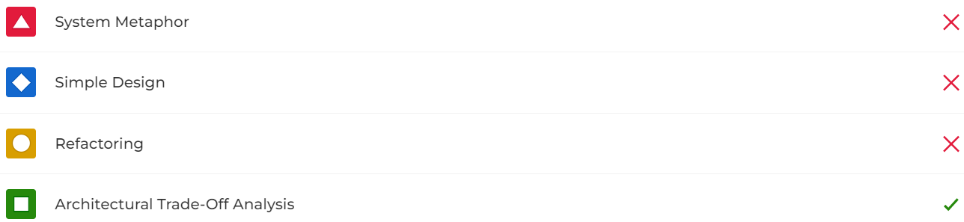

Slide 41
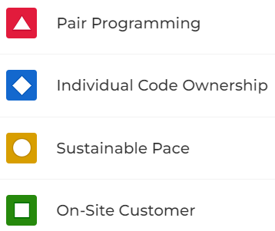

Slide 42
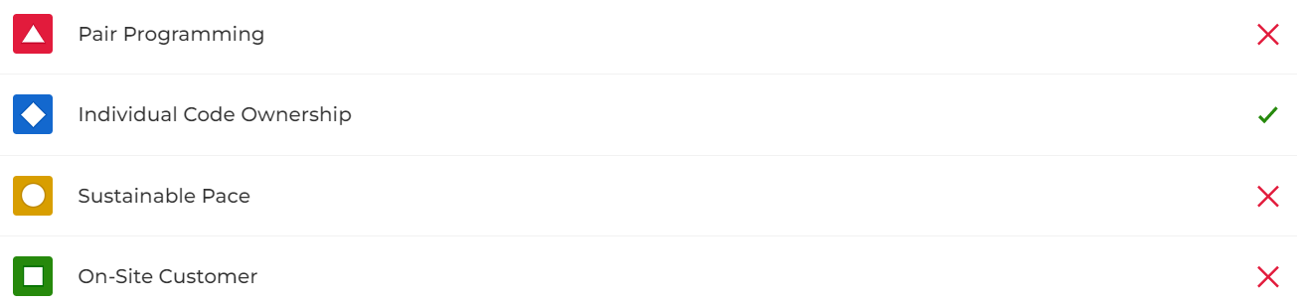

Slide 43
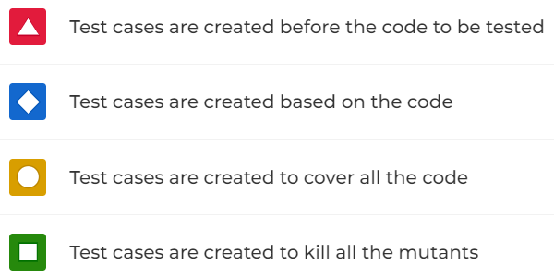

Slide 44
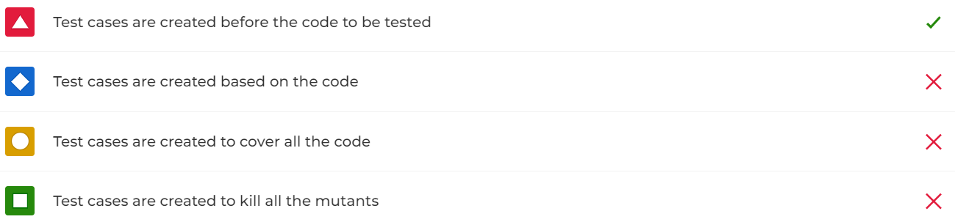

Slide 45
Requirements Engineering; Use Case and Domain Modeling

Slide 46
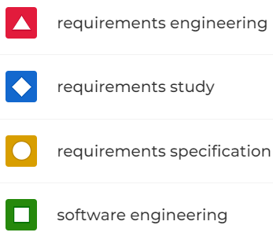

Slide 47
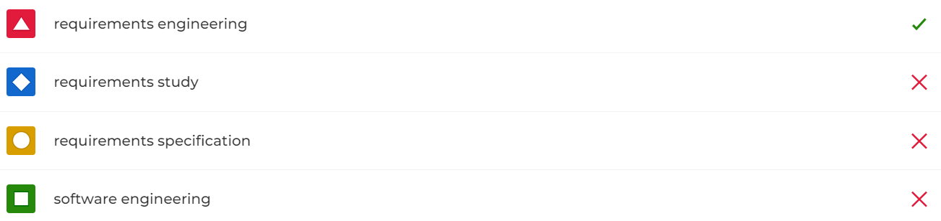

Slide 48
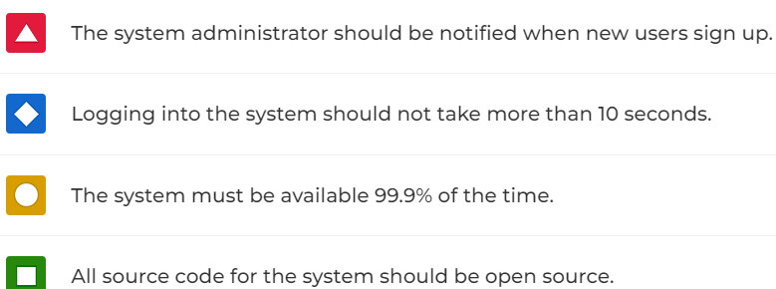

Slide 49
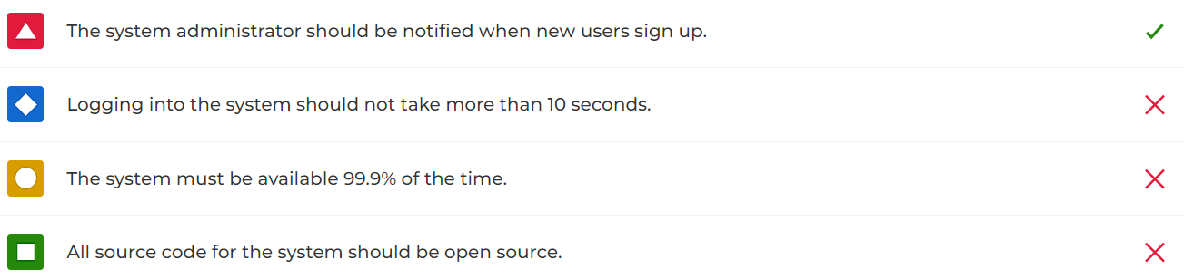

Slide 50
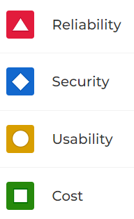

Slide 51
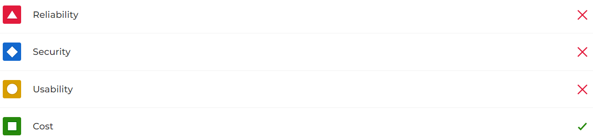

Slide 52
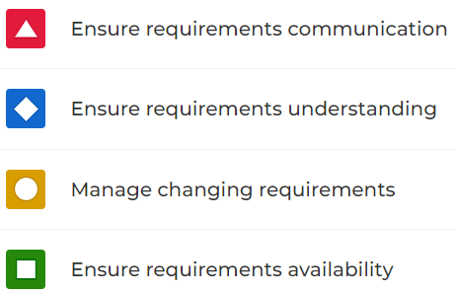

Slide 53
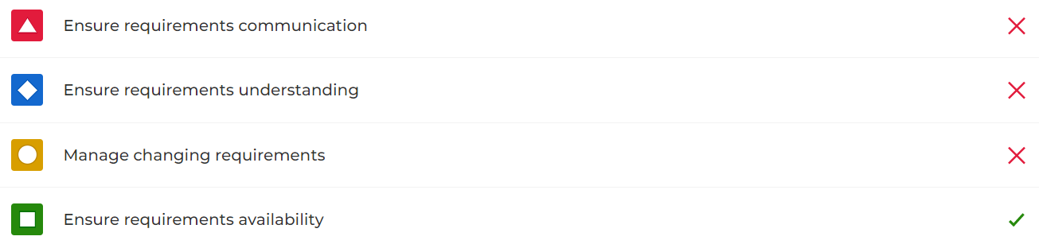

Slide 54
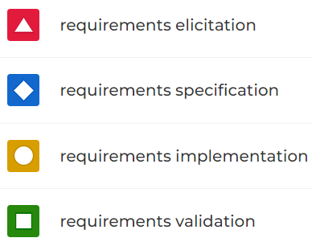

Slide 55
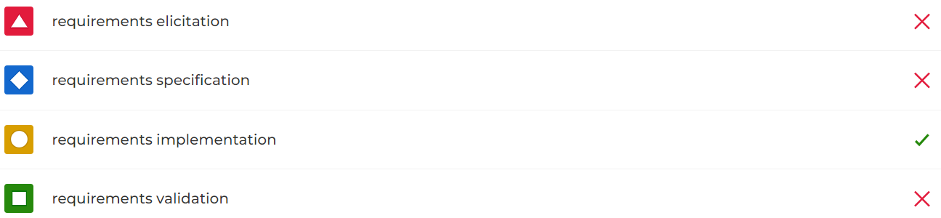

Slide 56
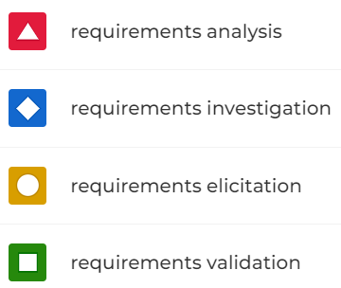

Slide 57
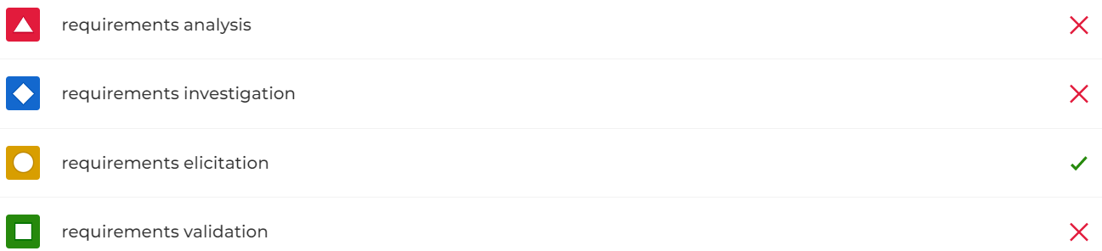

Slide 58
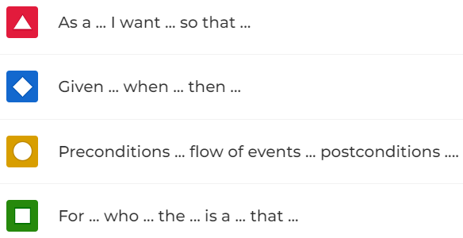

Slide 59


Slide 60


Slide 61


Slide 62


Slide 63


Slide 64


Slide 65


Slide 66


Slide 67


Slide 68


Slide 69


Slide 70


Slide 71


Slide 72


Slide 73


Slide 74


Slide 75


Slide 76



Slide 77


Slide 78
Architecture and Design

Slide 79


Slide 80


Slide 81


Slide 82


Slide 83


Slide 84


Slide 85


Slide 86


Slide 87


Slide 88


Slide 89


Slide 90


Slide 91


Slide 92


Slide 93


Slide 94


Slide 95


Slide 96


Slide 97


Slide 98


Slide 99


Slide 100


Slide 101


Slide 102


Slide 103
Software Testeing, Verification & Validation

Slide 104


Slide 105


Slide 106


Slide 107


Slide 108


Slide 109


Slide 110


Slide 111


Slide 112


Slide 113


Slide 114


Slide 115


Slide 116


Slide 117


Slide 118


Slide 119


Slide 120


Slide 121


Slide 122


Slide 123


Slide 124


Slide 125


Slide 126



Slide 127


Slide 128



Slide 129


Slide 130


Slide 131


Slide 132
Using JSON Web APIs in Dart

Slide 133


Slide 134


Slide 135


Slide 136


Slide 137



Slide 138


Slide 139


Slide 140


Slide 141


Slide 142


Slide 143



Slide 144


Slide 145


Slide 146


Slide 147



Slide 148


Slide 149
Behavior Modeling in UML

Slide 150


Slide 151


Slide 152


Slide 153


Slide 154


Slide 155


Slide 156



Slide 157


Slide 158


Slide 159


Slide 160


Slide 161


Slide 162



Slide 163


Slide 164


Slide 165


Slide 166


Slide 167


Slide 168



Slide 169


Slide 170
Software Project Management

Slide 171
PMBOK stands for
Project Management Base of Knowledge
Product Management Body of Knowledge
Project Management Body of Knowledge
People Management Base of Knowledge

Slide 172

Project Management Base of Knowledge
Product Management Body of Knowledge
Project Management Body of Knowledge
People Management Base of Knowledge

Slide 173
Which one is NOT a project lifecycle phase according to the PMBOK guide
Initiation
Planning
Monitoring & Control
Communication

Slide 174

Initiation
Planning
Monitoring & Control
Communication

Slide 175
Which one is NOT a control variable in the iron triangle of project management
Scope (features, functionality)
Resources (cost, budget)
Schedule (time)
Size (pages, LOC)

Slide 176
Scope (features, functionality)
Resources (cost, budget)
Schedule (time)
Size (pages, LOC)

Slide 177
Which one is NOT a characteristic of managing agile processes
Iterative and incemental
Heavy emphasis on collaboration
Dynamic project balancing via scope adjustments
Creation of comprehensive activity-based plans

Slide 178
Iterative and incemental
Heavy emphasis on collaboration
Dynamic project balancing via scope adjustments
Creation of comprehensive activity-based plans

Slide 179
“An ordered list of items (epics, stories, work items, etc.) needed to deliver the whole product” is called:
Iteration backlog
Product backlog
Kanban board
Sprint backlog

Slide 180

Iteration backlog
Product backlog
Kanban board
Sprint backlog

Slide 181
The MoSCoW method is used to assign _____ to product backlog items
priorities
effort estimates
schedule estimates
iterations

Slide 182

priorities
Effort estimates
Schedule estimates
iterations

Slide 183
T-shirts sizes are used in agile project management to estimate
effort of product backlog items
size of software components
duration of project iterations
cost of human resources

Slide 184
effort of product backlog items
size of software components
duration of progect iterations
cost of human resources

Slide 185
“A subset of items taken from the product backlog to be implemented in an iteration” is called the:
Iteration backlog
Iteration plan
Iteration to-do list
Iteration basket

Slide 186
Iteration backlog
Iteration plan
Iteration to-do list
Iteration basket

Slide 187
Which one is NOT a typical column in a project board (kanban board) on GitHub?
To do (or Product backlog, Iteration backlog, etc.)
In progress
Defered
Done

Slide 188

To do (or Product backlog, Iteration backlog, etc.)
In progress
Defered
Done

Slide 189
The maximum number of “in progress” items in a Kanban boardis called the:
Kanban limit
WIP limit
IP limit
Board limit

Slide 190

Kanban limit
WIP limit
IP limit
Board limit

Slide 191
Which one is NOT part of the “definition of done” (DOD) of user stories and work items
Implemented
Tested
Accepted to be valid and correct
Estimated

Slide 192
Implemented
Tested
Accepted to be valid and correct
Estimated

Slide 193
In agile processes, if the planned work is not completed at the end of an iteration, what should be done?
Extend the iteration until the work is completed
Move the work remaining to the next iteration
Discard the work remaining
Follow a contingency plan

Slide 194
Extend the iteration until the work is completed
Move the work remaining to the next iteration
Discard the work remaining
Follow a contingency plan

Slide 195
Mobile Technologies

Slide 196


Slide 197


Slide 198


Slide 199


Slide 200


Slide 201


Slide 202


Slide 203


Slide 204


Slide 205


Slide 206


Slide 207


Slide 208
Scrum

Slide 209
Iteration in Scrum (select the WRONG statement)
are called sprints
have a fixed duration
result in costumer-ready product increments
have a duration of 1 to 3 months

Slide 210
are called sprints
have a fixed duration
result in costumer-ready product increments
have a duration of 1 to 3 months

Slide 211
Which one is NOT a Scrum meeting?
Daily Meeting
Sprint Review
Weekly Meeting
Sprint Planning

Slide 212
Daily Meeting
Sprint Review
Weekly Meeting
Sprint Planning

Slide 213
Which one is NOT a Scrum artifact?
Product Backlog
Sprint Backlog
Gantt Chart
Burndown Chart

Slide 214
Product Backlog
Sprint Backlog
Gantt Chart
Burndown Chart

Slide 215
Which one is NOT a Scrum role?
Product Owner
Developers (Team)
Scrum Master
Project Manager

Slide 216
Product Owner
Developers (Team)
Scrum Master
Project Manager

Slide 217
Which of the following is NOT a responsability of the Scrum Master?
Accept or reject work results
Enact Scrum values and practices
Remove impediments
Ensure that the team is fully functional and productive

Slide 218
Accept or reject work results
Enact Scrum values and practices
Remove impediments
Ensure that the team is fully functional and productive

Slide 219
Which of the following is NOT a responsability of the Product Owner?
Defines the features of the product
Decide on release date and content
Estimate size of user stories in story points
Accept or reject work results

Slide 220
Defines the features of the product
Decide on release date and contente
Estimate size of user stories in story points
Accept or reject work results

Slide 221
What is the meeting that occurs at the begin of each sprint
Sprint Review
Sprint Retrospective
Daily Meeting
Sprint Planning

Slide 222
Sprint Review
Sprint Retrospective
Daily Meeting
Sprint Planning

Slide 223
What is the main output of the Sprint Planning meeting?
Product backlog
Sprint backlog
Sprint Schedule
Product increment

Slide 224
Product backlog
Sprint backlog
Sprint Schedule
Product increment

Slide 225
What is the goal of the Sprint Review meeting?
The team presents what it accomplished in the sprint
Stand-up meeting for coordination among peers
The team discusses what they like to start/stop/continue
The team reviews the features to implemente the next sprint

Slide 226
The team presents what it accomplished in the sprint
Stand-up meeting for coordination among peers
The team discusses what they like to start/stop/continue
The team reviews the features to implemente the next sprint

Slide 227
Which quetion is OUT OF SCOPE of the Sprint Retrospective?
What the team did well
What the team should do differently
What features have been fully implemented
What does still puzzle the team

Slide 228
What the team did well
What the team should do differently
What features have been fully implemented
What does still puzzle the team

Slide 229
Select the WRONG statement about Scrum teams
Typically 5-9 people
Members should be full-time
Membership may change at any time
Teams are self-organizing

Slide 230
Typically 5-9 people
Members should be full-time
Membership may change at any time
Teams are self-organizing

Slide 231
Which quetion is NOT a key practice of Scrum
Organize work in short cycles
Define work goals through user stories
The team decides how much work they can do in an iteration
The team reports to top management, not to the client

Slide 232
Organize work in short cycles
Define work goals through user stories
The tem decides how much work they can do in na iteration
The team reports to top management, not to the client

Slide 233
Software Construction and Evolution

Slide 234


Slide 235


Slide 236



Slide 237


Slide 238


Slide 239


Slide 240


Slide 241


